Slide 1
Management models
Session 32

Slide 2
For an organization to survive it will need to evolve. For it to evolve, you need to make changes. Without a change management model, the success of those changes is up to nothing more than hope and luck.

Slide 3
8 Change management models
Lewin’s change management model
The McKinsey 7-S model
Kotter’s theory
Nudge theory
ADKAR
Bridges’ transition model
Kübler-Ross’ change curve
The Satir change management model

Slide 4
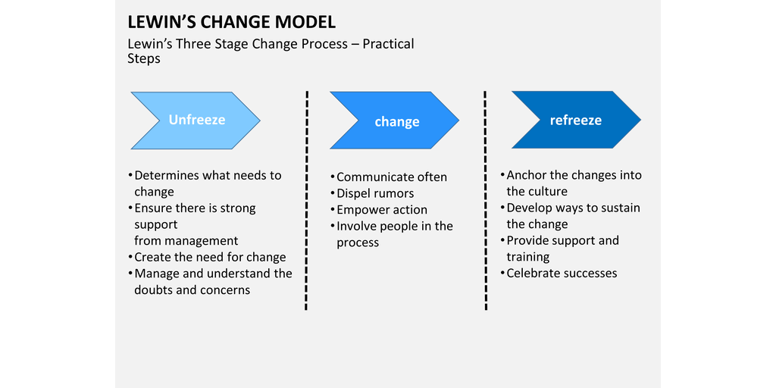
Lewin’s change management model

Slide 5
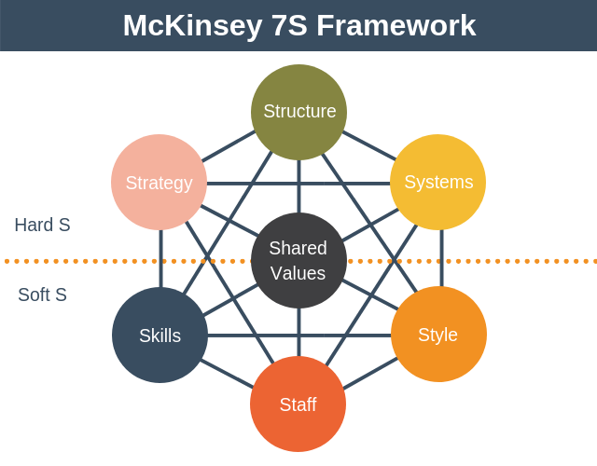
The McKinsey 7-S model

Slide 6
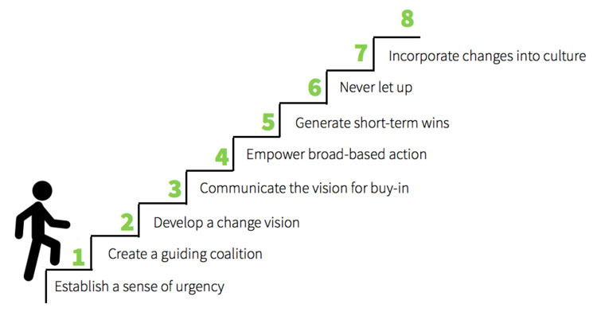
Kotter’s theory

Slide 7
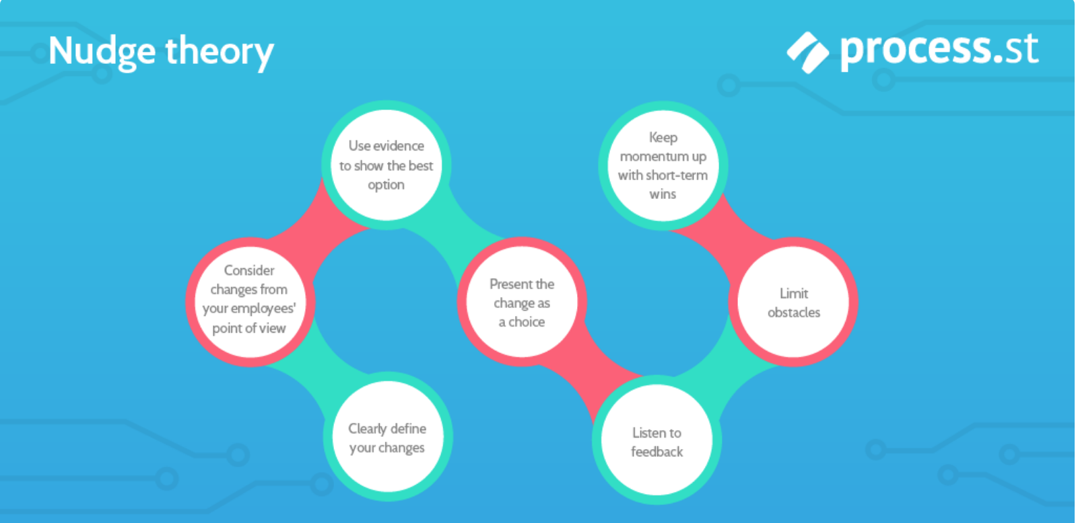
Nudge Theory

Slide 8
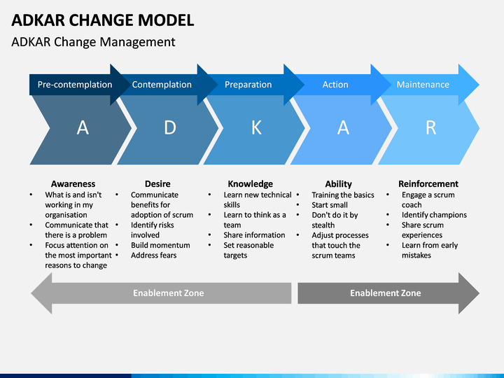

Slide 9
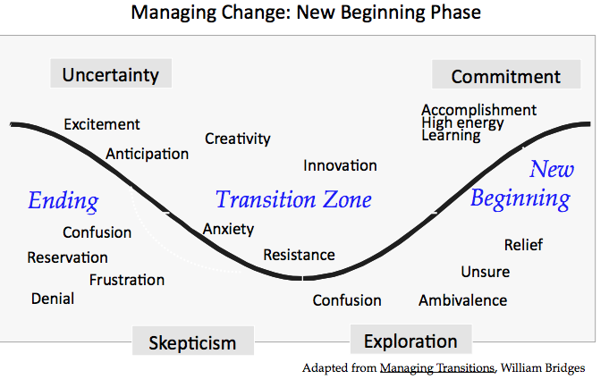
Bridge’s transition model

Slide 10
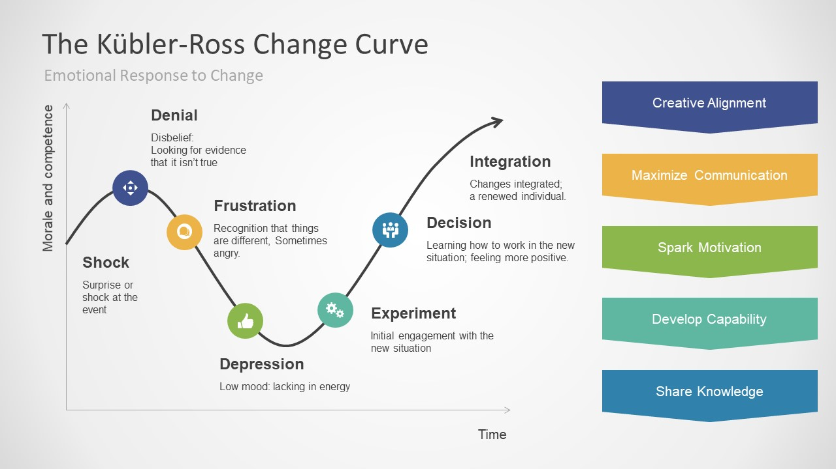
Kubler Ross change curve

Slide 11
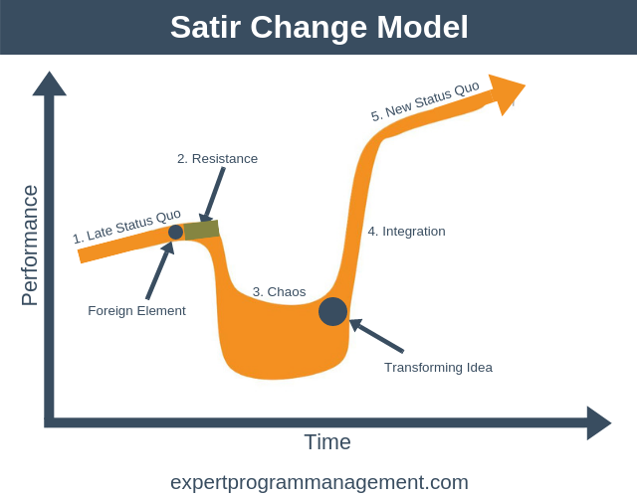
Satir Change management model

